Slide 1

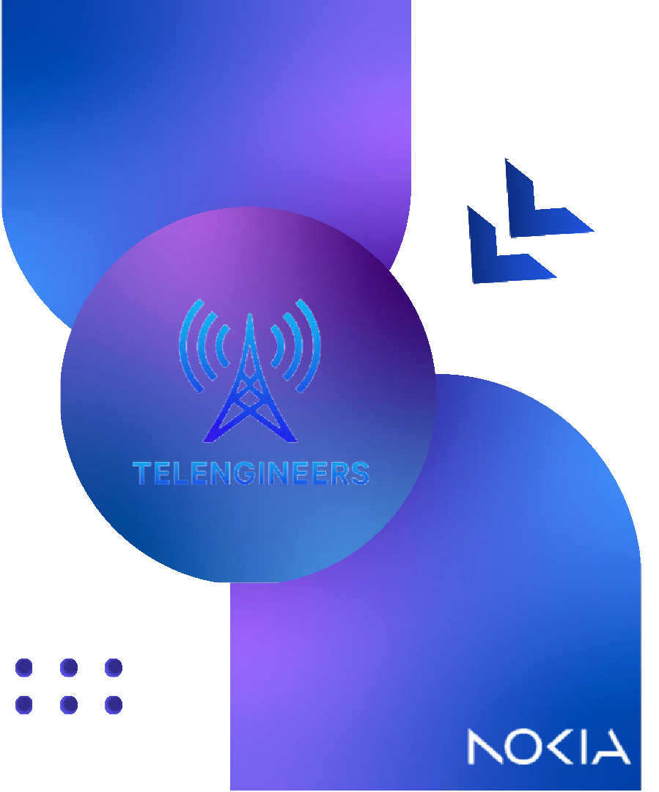

OUR TEAM:
Danah Alosaimi
Deem Alsuhaibani
Muneera Alyemni
Nawaf Alferaih
Superviso
Hro:ssam ElSayed
1
© 2025 Nokia

Slide 2
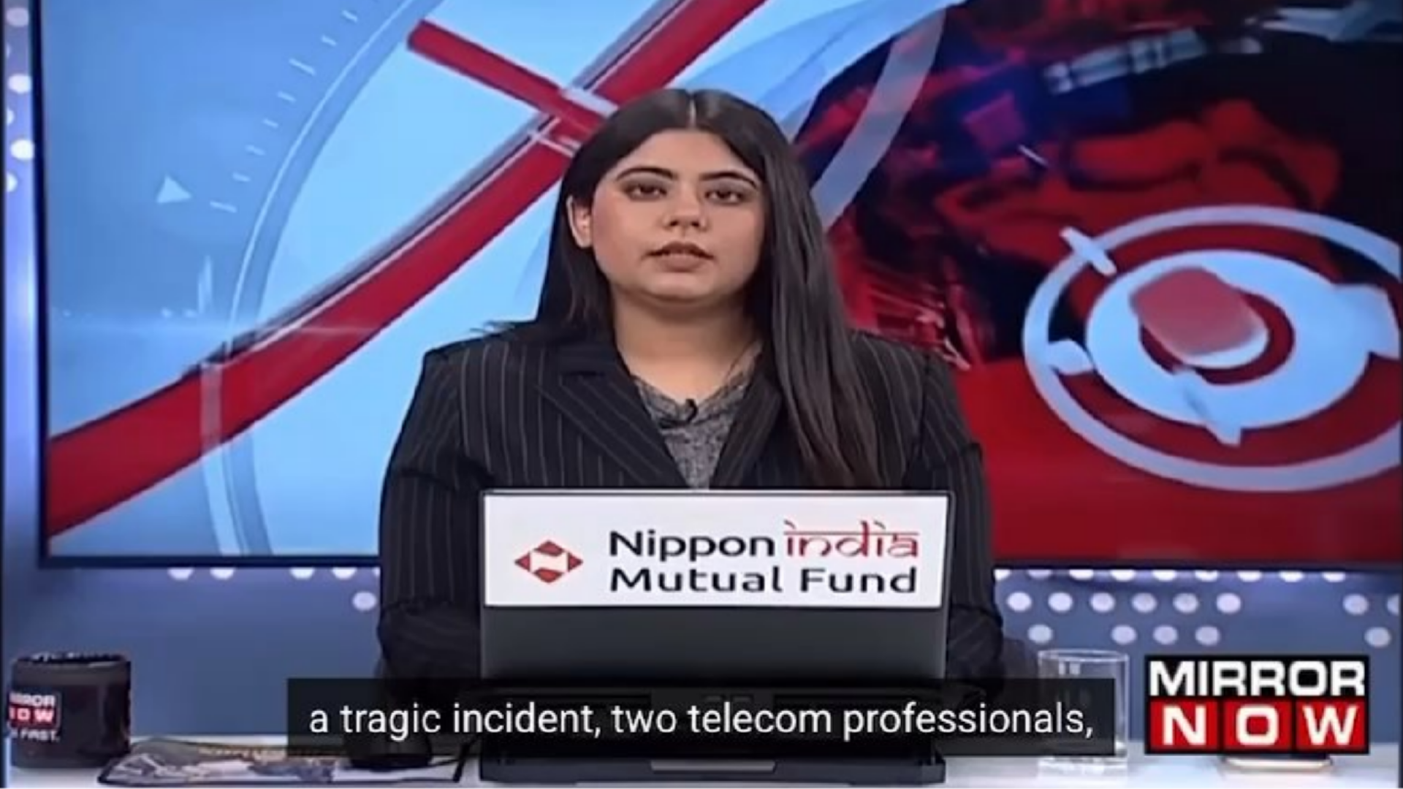
2

Slide 3


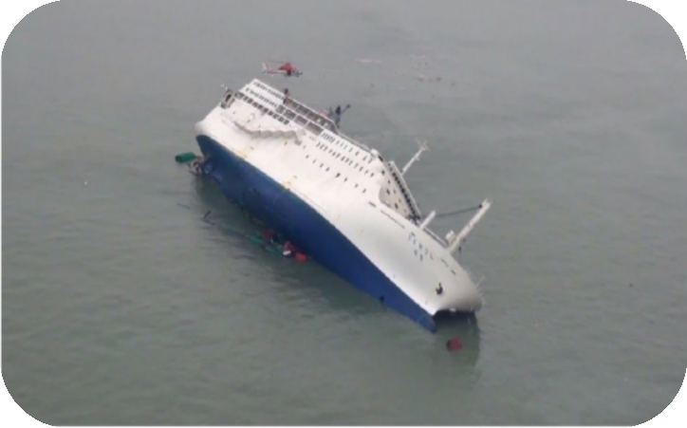




Lost In Rub’ Al Khali (2024)
&
The Sewol Ferry incident
(2014)
2 people lost their lives
Terrestrial networks failed in remote
environment
No Direct-to-Device was used
304 fatalities
Relied on VHF radio to send distress
signals
No satellite-linked system was in place to
transmit real-time location
3
© 2025 Nokia

Slide 4
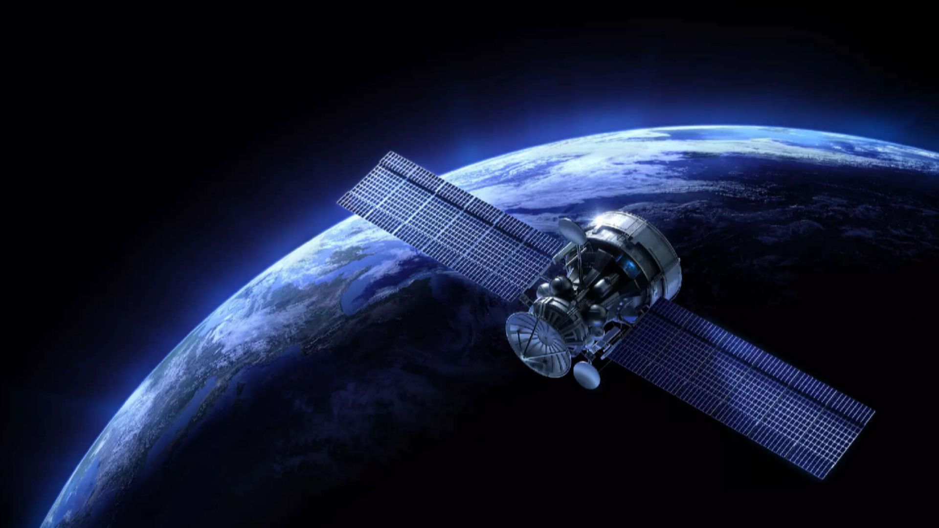

NTN Satellites: The Game
B_{C}y: T_{h}elen_{a}gin_{n}eer_{g}s /_{e}13 _{r}Aug 2025

Slide 5

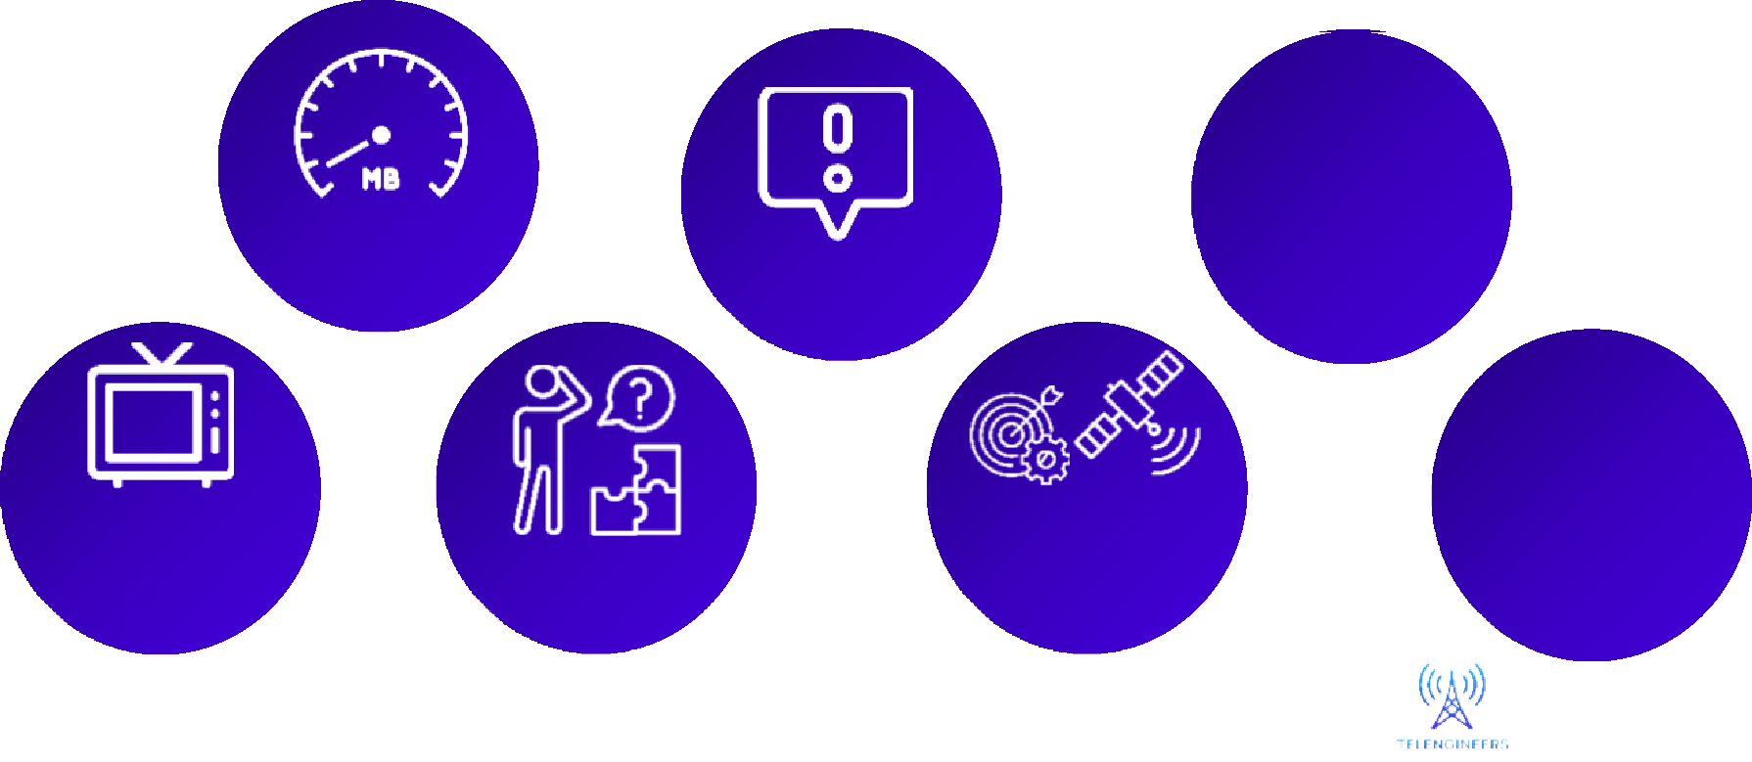



Legacy Perceptions About Satellite Communications
High latency
Too expensive
Not reliable
Satellites are only for TVs
All satellites are the same
Connects to special devices
Too complex

Slide 6
Legacy Perceptions About Satellite Communications
High latency
Too expensive
Not reliable
Satellites are only for TVs
All satellites are the same
Connects to special devices
Too complex

Slide 7
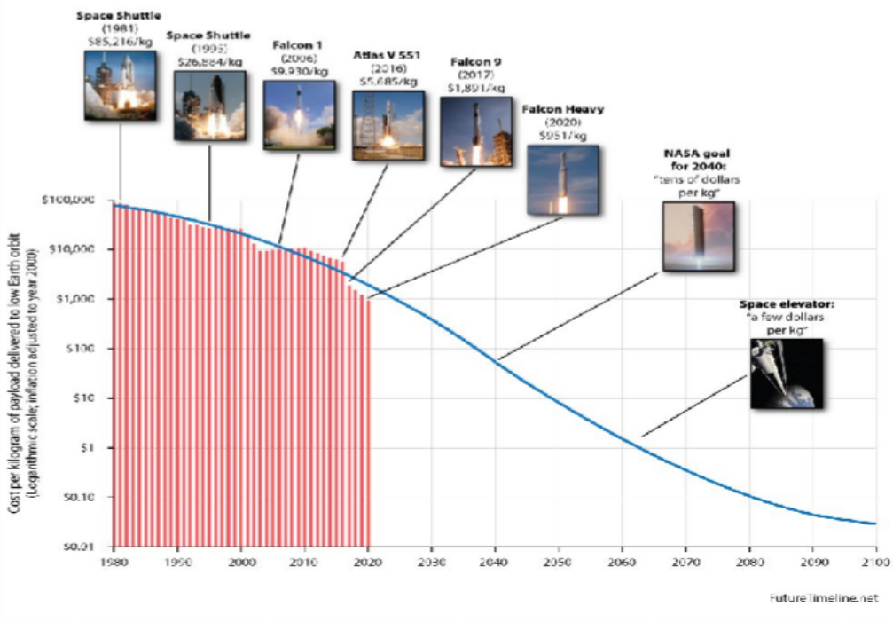

The Shift to Low Earth Orbit (LEO)
h
ace Economy explosion driven by the launc cost reduction
Sp

Slide 8
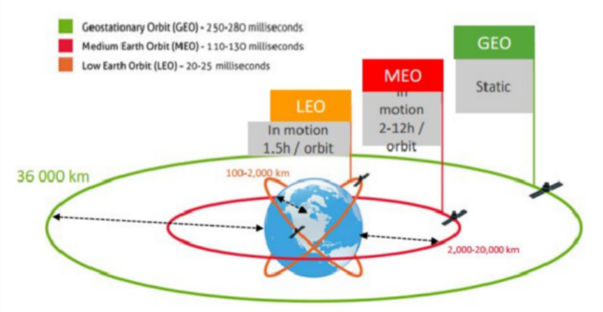
Satellite Orbits
LEO: Low Earth Orbit
200 – 2000 (km) altitude with 10-40 minutes orbital period. Closest to earth, fast-moving, and low latency (20-40 ms). Used in IoT, disaster response, and earth observing.
Challenges include large constellation for global coverage and high debris concentration.
MEO: Medium Earth Orbit
2000 – 30k (km) altitude with 2 – 8 hours orbital period. Balanced coverage and latency (100 – 150 ms).
Used for Navigation Systems (GPS).
Challenges include higher costs than LEO orbit and moderate debris concentration.
GEO: Geosynchronous Earth Orbit
36k km altitude with 24h orbital period. Fixed position over equator, wide coverage.
Used for TV broadcasting, weather monitoring, long-distance communication. Challenges include high latency and costs.

Slide 9








Meet Our Friends!

Slide 10
Role of Satellites in Aeronautical Systems

Slide 11
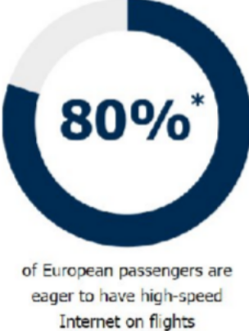
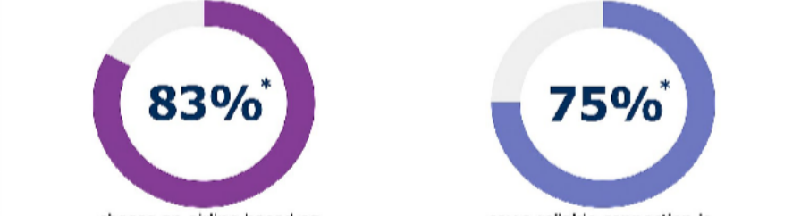
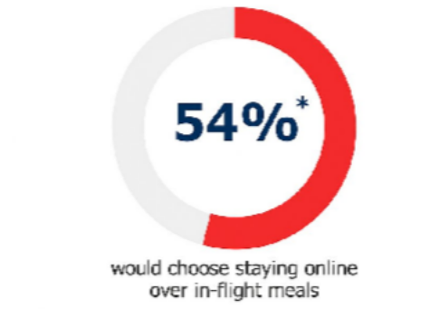
Meeting The Demands of Passengers
Worldwide travelers now expect to stay connected via their smart devices and laptops when they are in the sky. In-flight connectivity has become a key differentiator in airline choice.
Choose an airline based on broadband availability
Say a reliable connection is more important than speed
… plus airline crews asking for connectivity with ground staff for airline efficiency improvements (electronic flight bag, info on gate changes, …)
11
* 2016 In-Flight Connectivity Survey conducted by Inmarsat (LSE: ISAT.L), the leading provider of global mobile satellite communications services, and market research company GfK.

Slide 12




Choosing The Right Orbit For The Skies
Two main options to connect aircrafts
LEO GEO
Lo₊wer cost per bit for affordable broadband services
H₋igher cost per bit H₋igh latency
Low latency
+
Quick on-board equipment installation time (no
Long on-board equipment installation
+
immobilization)
- time (1 week immobilization)
Low on-board equipment weight
-
+
High on-board equipment weight
(lower fuel consumption) and size
(higher fuel consumption) and size
Covers land and sea
C₊overs lands and sea
+
“World’s first and only home-like Inte₁₂ rnet experience
12
onboard”

Slide 13









LEO Technical Solution
Cabin Network
CS
CS
Cabin Server
Aircraft IoT Platforms
Airline Operations
MME
HSS
Auth.
Billing
Centers
SGW
PGW
DPI/LI
www
Radio Access Network
Core Network
Roaming and
wholesale partners
13

Slide 14
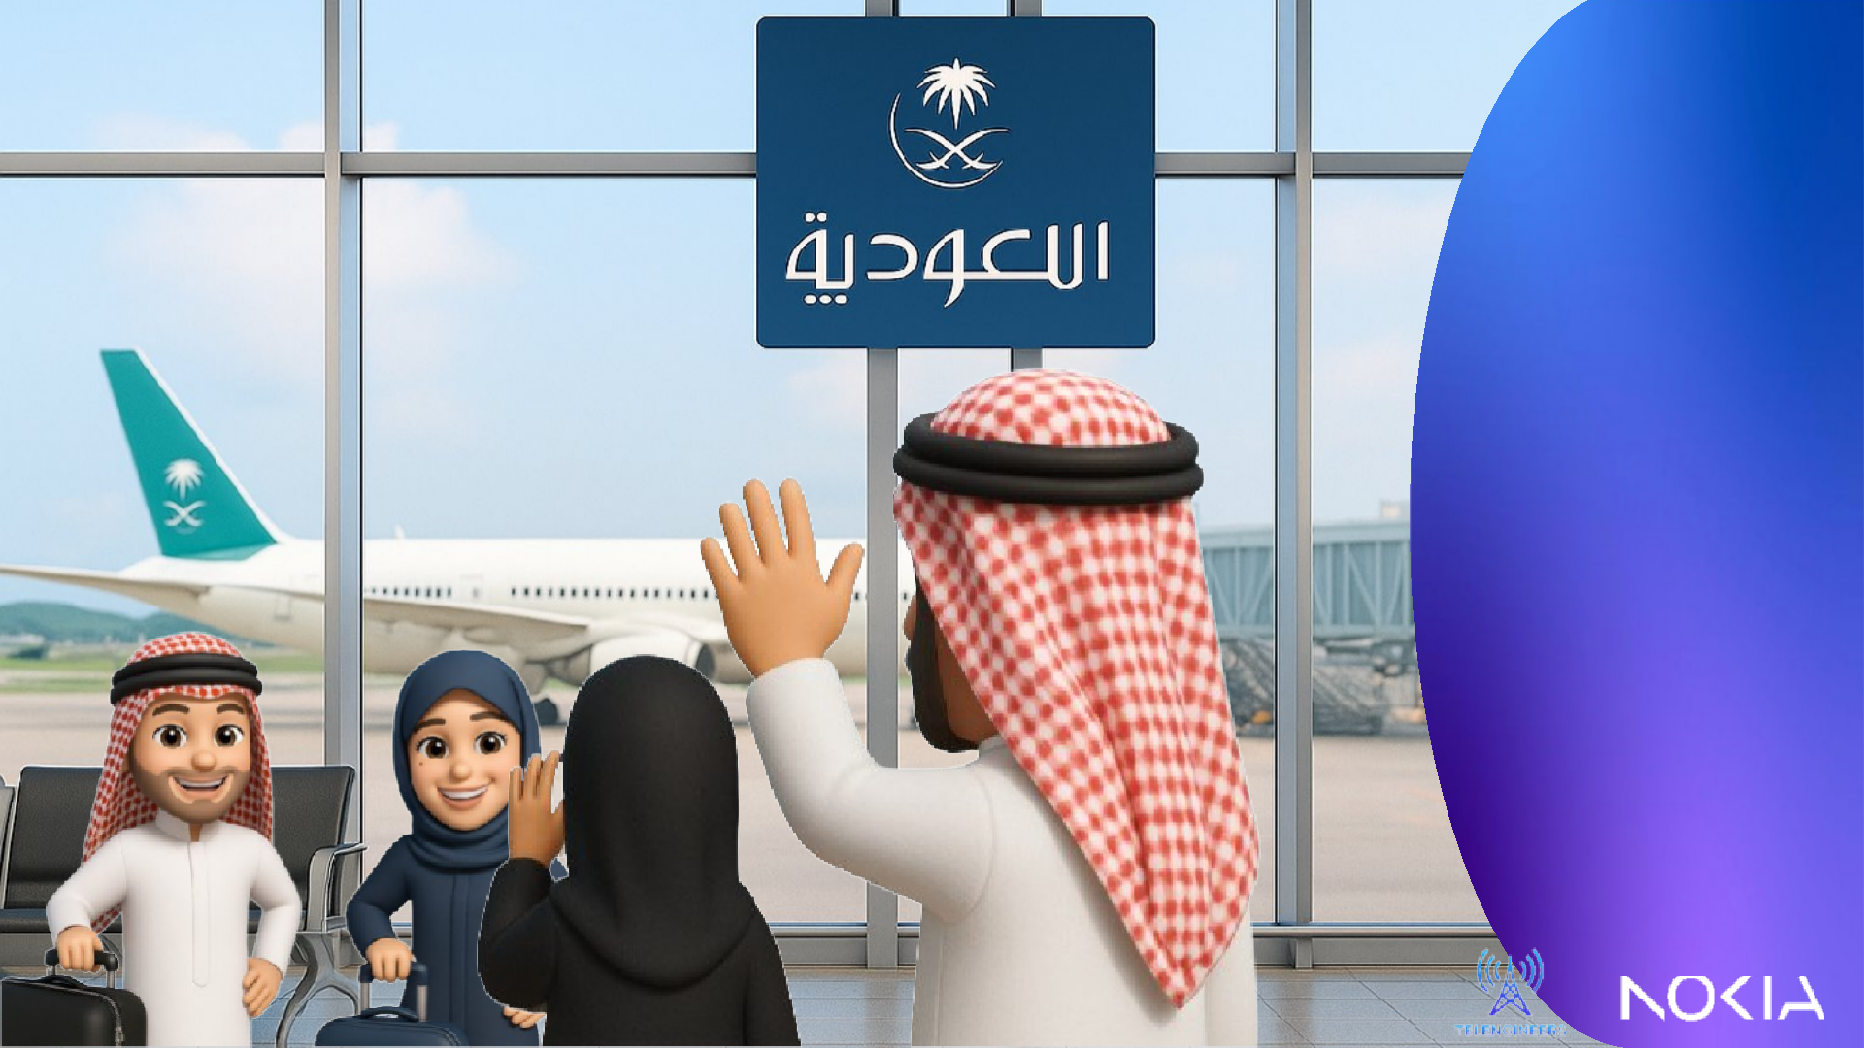
Amal and Abdullah landed safely – and now, with LEO satellite internet, they’re always connected in the air, keeping their parents worry-free!

Slide 15



















































Slide 16
Fixed Wireless Access (FWA) via Satellites

Slide 17
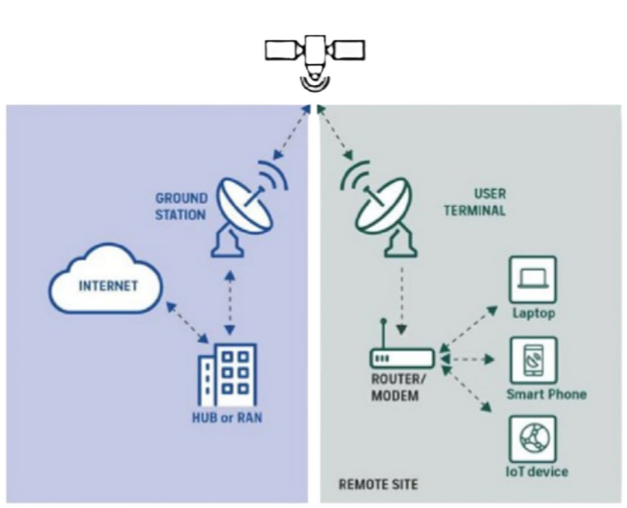
Fixed Wireless Access (FWA)
Fixed Wireless Access (FWA) is a wireless connection that provides broadband access to a specific location such as a home or enterprise premises.
4G/5G Support
No cables needed
Fiber-like speeds
Urban/Rural Cost Advantages
Remote Connectivity
17

Slide 18





Why Satellites for FWA?
Overcomes Physical Barriers
Stronger Resilience
Supports Wide-Area Deployments
Complements, Not Replaces

Slide 19






Slide 20

Direct to Device - Anytime, Anywhere

Slide 21
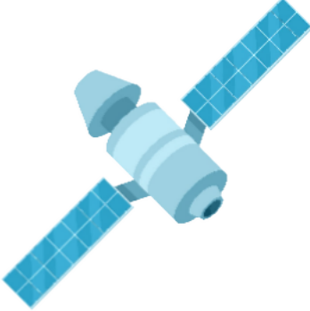
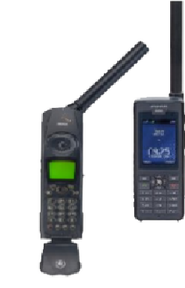
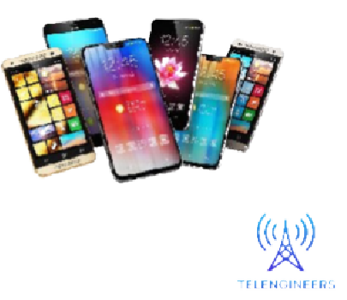
Direct-To-Device / IoT SatCom
The ability of satellites, particularly in Low Earth Orbit (LEO), to connect directly to standard consumer mobile devices—such as smartphones—without the need for specialized satellite phones or ground infrastructure like cell towers.

Slide 22


The Power of D2D Satellite Connectivity
Global Coverage (100% territory coverage)
Bridging Digital Divide (Coverage Gaps)
No Need For Special Devices (Standard Mobile)
Disaster Resilience (24/7 Connectivity)

Slide 23
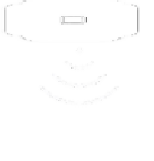








Functionality of Space-Based Cellular Broadband Network
SAT Field of View
~2800 km diameter
Service Link
MNO Existing spectrum 698-960 MHz / 1.7-2.5 GHz
Feeder Link
Service Link
Feeder Link
Q band 37.5-42.5 GHz (DL) and 47.2-52.4 GHz (UL)
Cell Coverage
48Km in low band or 24km in mid band
Antenna BPMS
Transport
(IP/Optics)
Core
(5GC, IMS)
AirScale Baseband
Beams/Cells
Ground Station
(MNO designated)
MNO
(Existing Network)

Slide 24
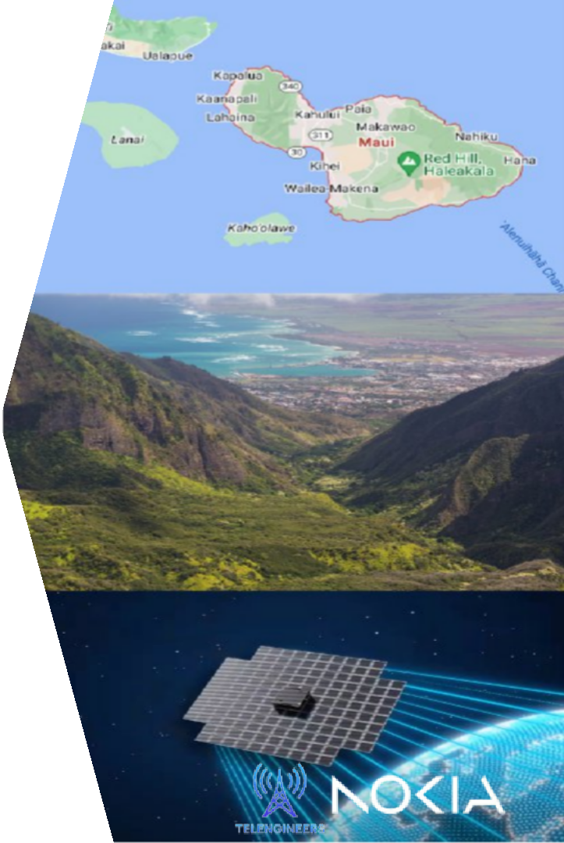
World’s First Space-Based 5G Cellular Network
Achieved By AST SpaceMobile & Nokia
BlueWalker 3, a 693-square-foot test— the largest such commercial telecommunications array in low Earth orbit. Which is designed to communicate directly with cellular devices via 3GPP standard frequencies. Engineers at AST SpaceMobile made history on September 8, 2023, by demonstrating the first-ever 5G cellular connectivity from space directly to everyday smartphones. The company proved the feat using AT&T cellular spectrum in Maui, Hawaii, to make a voice call to Vodafone in Madrid, Spain. The call was facilitated by Nokia’s network core.

Slide 25


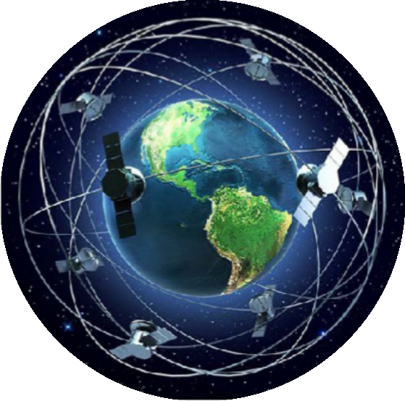

Conclusio n

Slide 26




Slide 27

Thank You!

